Slide 1
Equivalence Partitioning / Classes
Equivalence partitioning or equivalence class partitioning (ECP) is a software testing technique that divides the input data of a software unit into partitions of equivalent data from which test cases can be derived.
In principle, test cases are designed to cover each partition at least once.
This technique tries to define test cases that uncover classes of errors, thereby reducing the total number of test cases that must be developed.
An advantage of this approach is reduction in the time required for testing software due to lesser number of test cases.

Slide 2
… Equivalence Partitioning / Classes …
Equivalence partitioning is typically applied to the inputs of a tested component, but may be applied to the outputs in rare cases.
The set of input values that generate one single expected output is called a partition/ class.
The equivalence partitions are usually derived from the requirements specification for input attributes that influence the processing of the test object.
In general an input has certain ranges which are valid and other ranges which are invalid. Invalid data here does not mean that the data is incorrect, it means that this data lies outside of specific partition.

Slide 3

… Equivalence Partitioning / Classes …
This may be best explained by the example of a function which takes a parameter "month".
The valid range for the month is 1 to 12, representing January to December.
This valid range is called a partition.
In this example there are two further partitions of invalid ranges.
The first invalid partition would be ≤ 0
and the second invalid partition would be ≥ 13.

Slide 4
… Equivalence Partitioning / Classes …
The testing theory related to equivalence partitioning says that only one test case of each partition is needed to evaluate the behaviour of the program for the related partition.
In other words, it is sufficient to select one test case out of each partition to check the behaviour of the program.
To use more or even all test cases of a partition will not find new faults in the program.
The values within one partition are considered to be "equivalent". Thus the number of test cases can be reduced considerably.

Slide 5
… Equivalence Partitioning / Classes …
Equivalence partitioning is not a stand-alone method to determine test cases.
It has to be supplemented by boundary value analysis. Having determined the partitions of possible inputs the method of boundary value analysis has to be applied to select the most effective test cases out of these partitions.

Slide 6
… Equivalence Partitioning / Classes …
The set of input vales that generate one single expected output is called a partition.
When the behaviour is same for a set of values then the set is termed as an equivalence class or a partition.
In this case, one representative sample of each partition (also called the member of the equivalence class ) is picked up for testing.
STEPS:
Identify all partitions for the complete set of input.
Identify/calculate corresponding output
Pick one member from each partition for testing.

Slide 7
… Equivalence Partitioning / Classes - Example
Life insurance Premium Rates
A life insurance company has base premium of $0.50 for all ages. Based on the age group, an additional monthly premium has to be paid that is as listed in the table below.
For example, a person aged 34 has to pay a premium= base premium + additional premium=$0.50+$1.65=$2.15
Age Group (Year) | Additional Premium
Under 35 | $1.65
35-59 | $2.87
60+ | $6.00

Slide 8
… Equivalence Partitioning / Classes – Example …
… Life insurance Premium Rates …
Based on the equivalence partitioning technique, the equivalence partitions that are based on age are given below:
Below 35 years of age →Valid input
Between 35 and 59 years of age →Valid input
Above 60 years of age. →Valid input
Negative age →invalid input
Age as 0 →invalid input
Age as any three digit number →Valid input

Slide 9
… Equivalence Partitioning / Classes – Example …
… Life insurance Premium Rates …
We need to pick up representative values from each of the above partitions and generate test cases.
S. N0. | Equivalence partitions | Type of Input | Test Data (Age) | Expected Results (Monthly Premium - $)
1 | Below 35 years of age | Valid | 26, 12 | Monthly premium= 0.50+1.65=2.15
2 | Between 35 and 59 years of age | Valid | 37 | Monthly premium= 0.50+2.87=3.37
3 | Above 60 years of age | Valid | 65, 90 | Monthly premium= 0.50+6.0=6.5
4 | Negative age | Invalid | -23 | Warning message – Invalid Input
5 | Age as 0 | Invalid | 0 | Warning message – Invalid Input

Slide 10
Boundary Value Analysis
Boundary value analysis is a software testing technique in which tests are designed to include representatives of boundary values in a range.
The idea comes from the boundary.
Those inputs which belong to the same equivalence class as defined by the equivalence partitioning theory would constitute the basis.
Given that the basis sets are neighbours, there would exist a boundary between them.
The test data on either side of the boundary are called boundary values.
The boundary between two partitions is the place where the behavior of the application changes.
The boundary value is the minimum (or maximum) value that is at the boundary.

Slide 11

… Boundary Value Analysis …
For example, if the input values were months of the year, expressed as integers, the input parameter 'month' might have the following partitions:
The number 0 is the maximum number in the first partition,
the number 1 is the minimum value in the second partition,
both are boundary values.
Test cases should be created to generate inputs or outputs that will fall on and to either side of each boundary, which results in two cases per boundary.
The test cases on each side of a boundary should be in the smallest increment possible for the component under test, for an integer this is 1, but if the input was a decimal with 2 places then it would be .01.
In the example above there are boundary values at 0,1 and 12,13 and each should be tested.
Where a boundary value falls within the invalid partition the test case is designed to ensure the software component handles the value in a controlled manner.

Slide 12
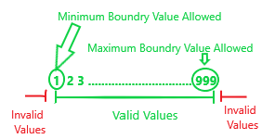
… Boundary Value Analysis …
… Life insurance Premium Rates …

Slide 13
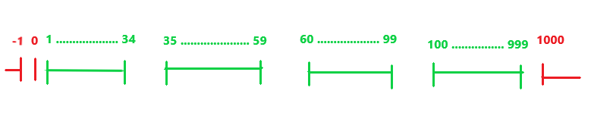
… Boundary Value Analysis …
… Life insurance Premium Rates …

Slide 14
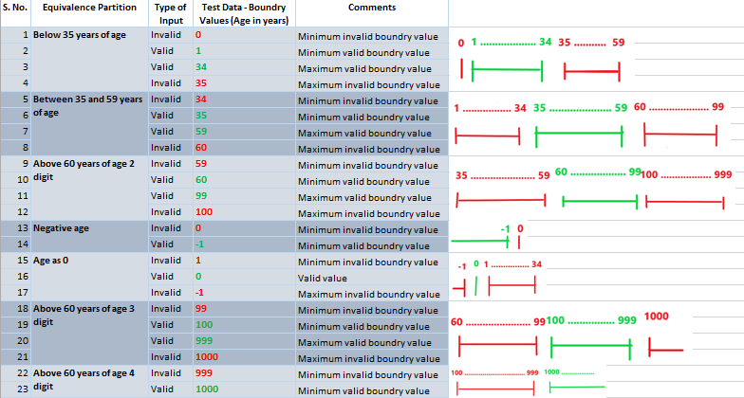
… Equivalence Partitioning / Classes – Example …
… Life insurance Premium Rates …

Slide 15
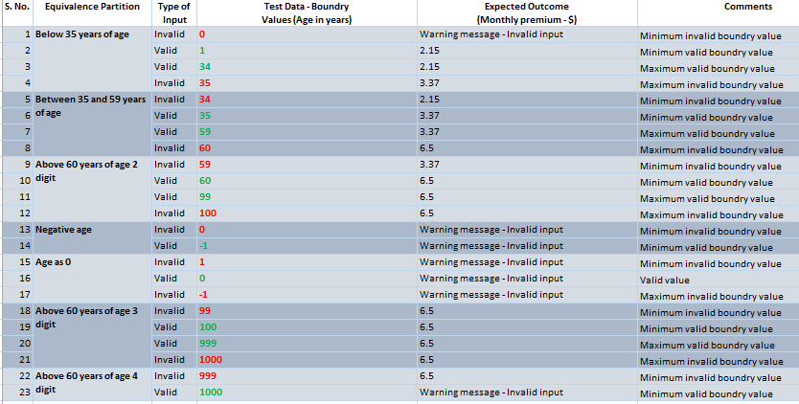
… Equivalence Partitioning / Classes – Example …
… Life insurance Premium Rates …

